Slide 1

Wear′s the Party!
Paul Lammertsma
CTO, Pixplicity

Slide 2
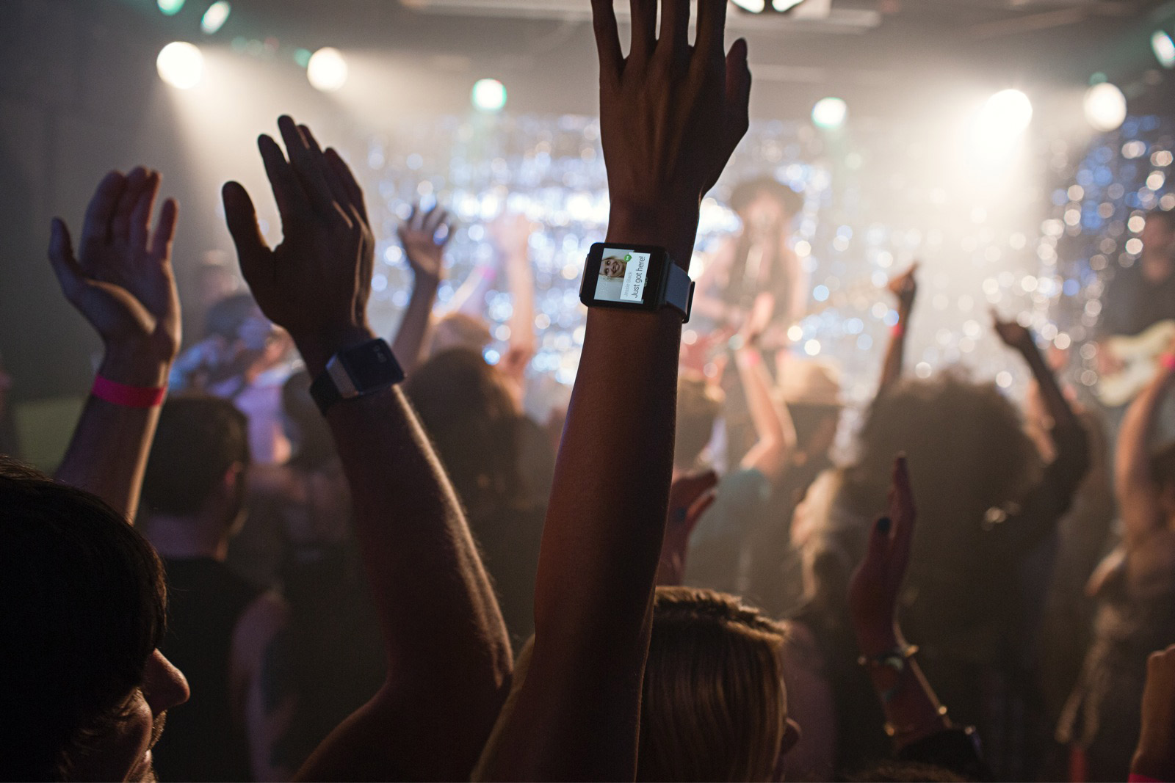
Wear′s the Party!
Paul Lammertsma
CTO, Pixplicity

Slide 3
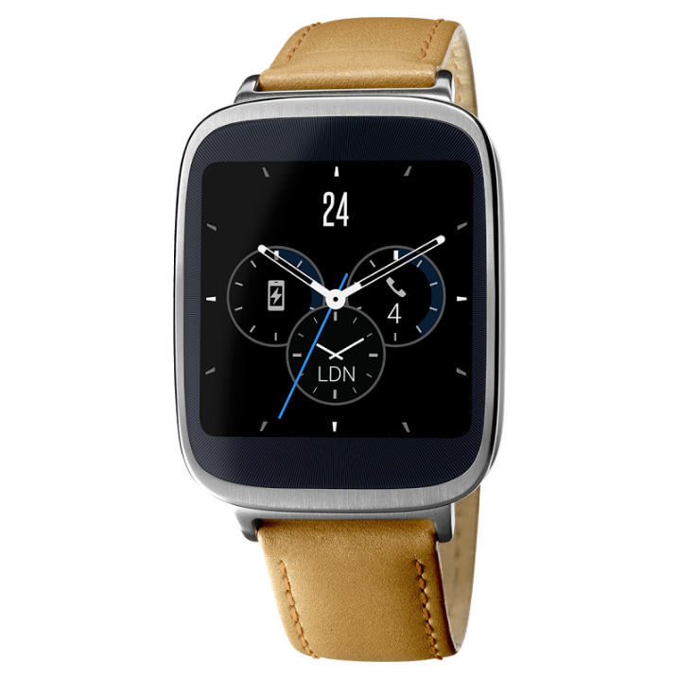
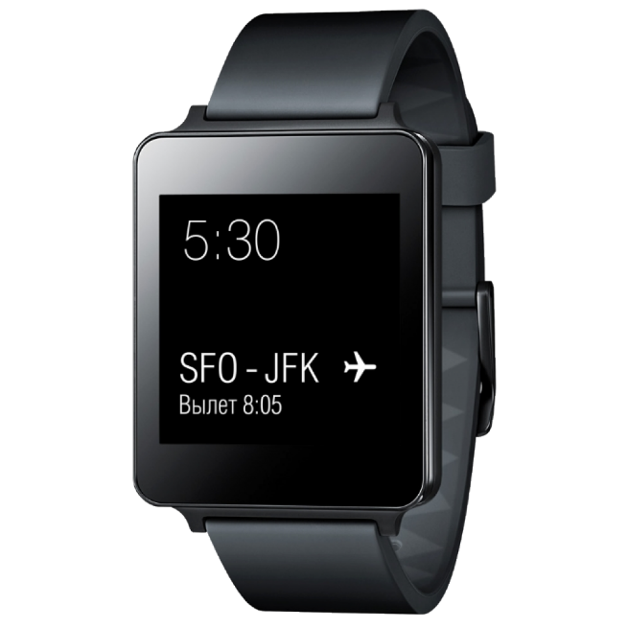
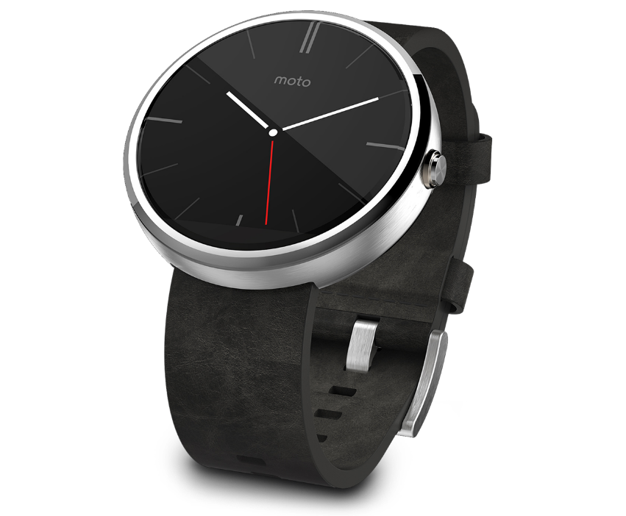
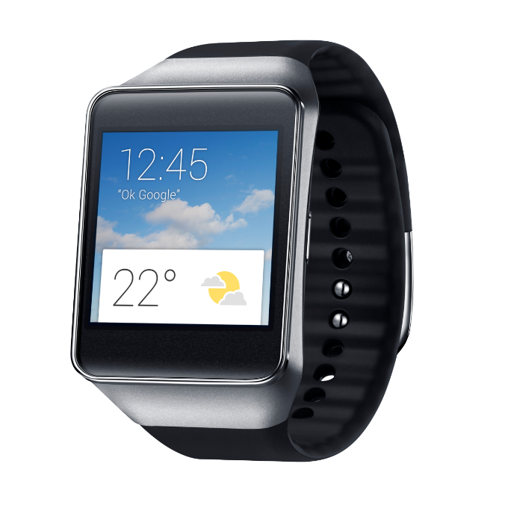
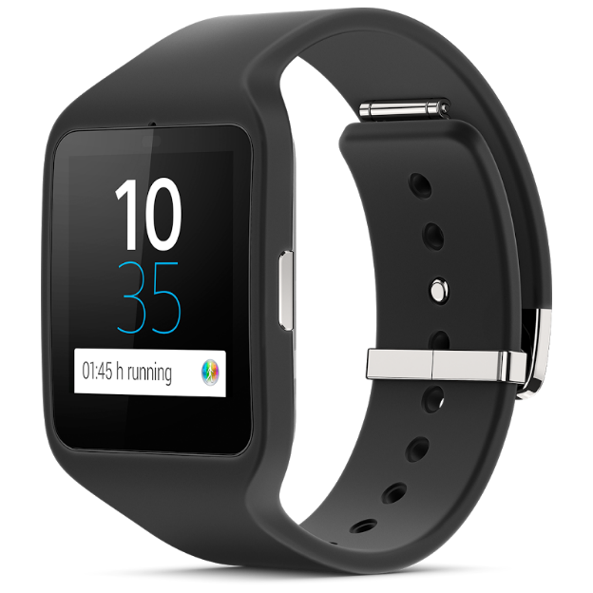
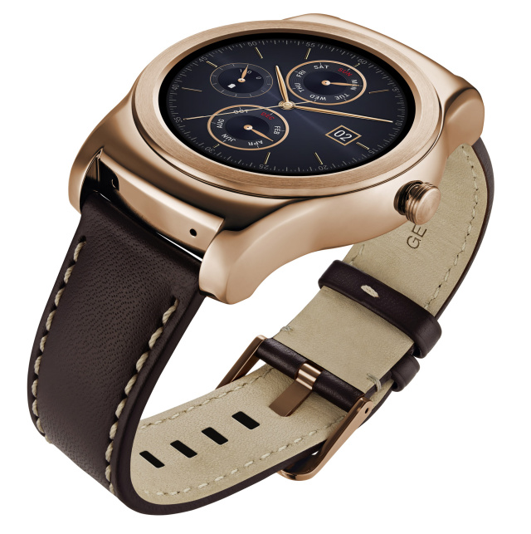
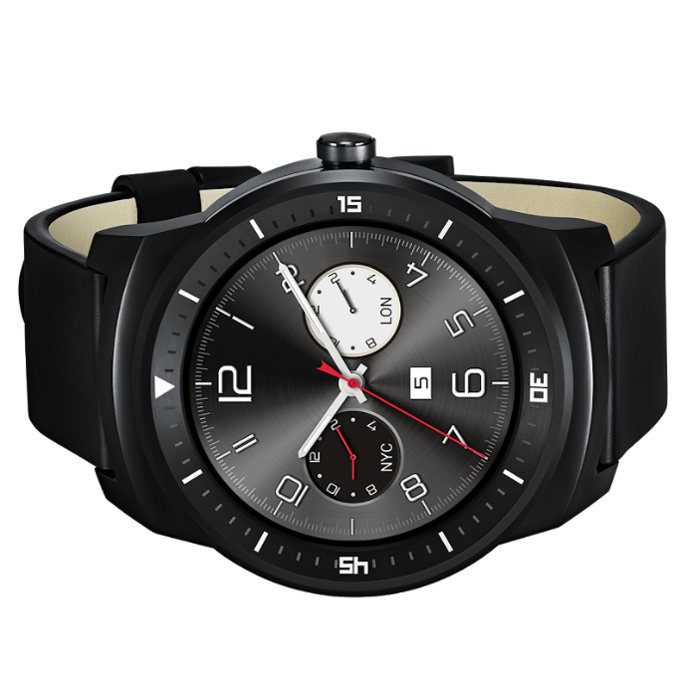
Notes:
The party started in March 2014.
Left to right: Sony Smartwatch 3, Samsung Gear Live, Asus Zenwatch, LG G Watch, LG Watch Urbane, Motorola Moto 360, (front) LG G Watch R

Slide 4
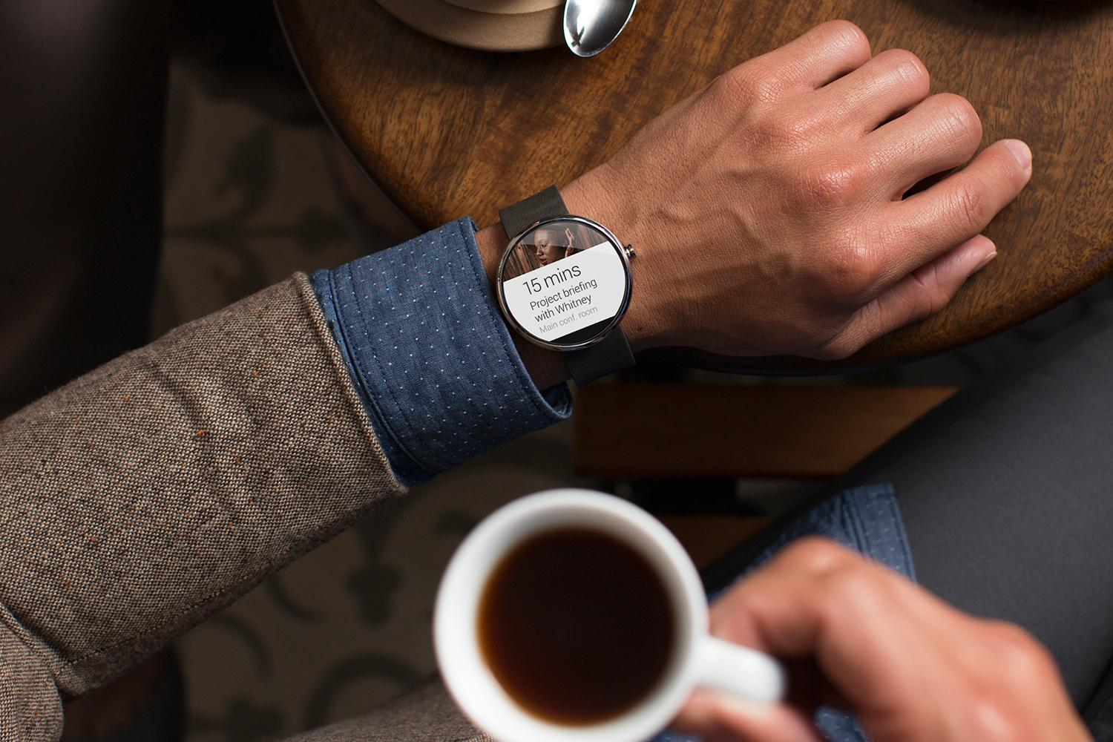
Short demo

Slide 5
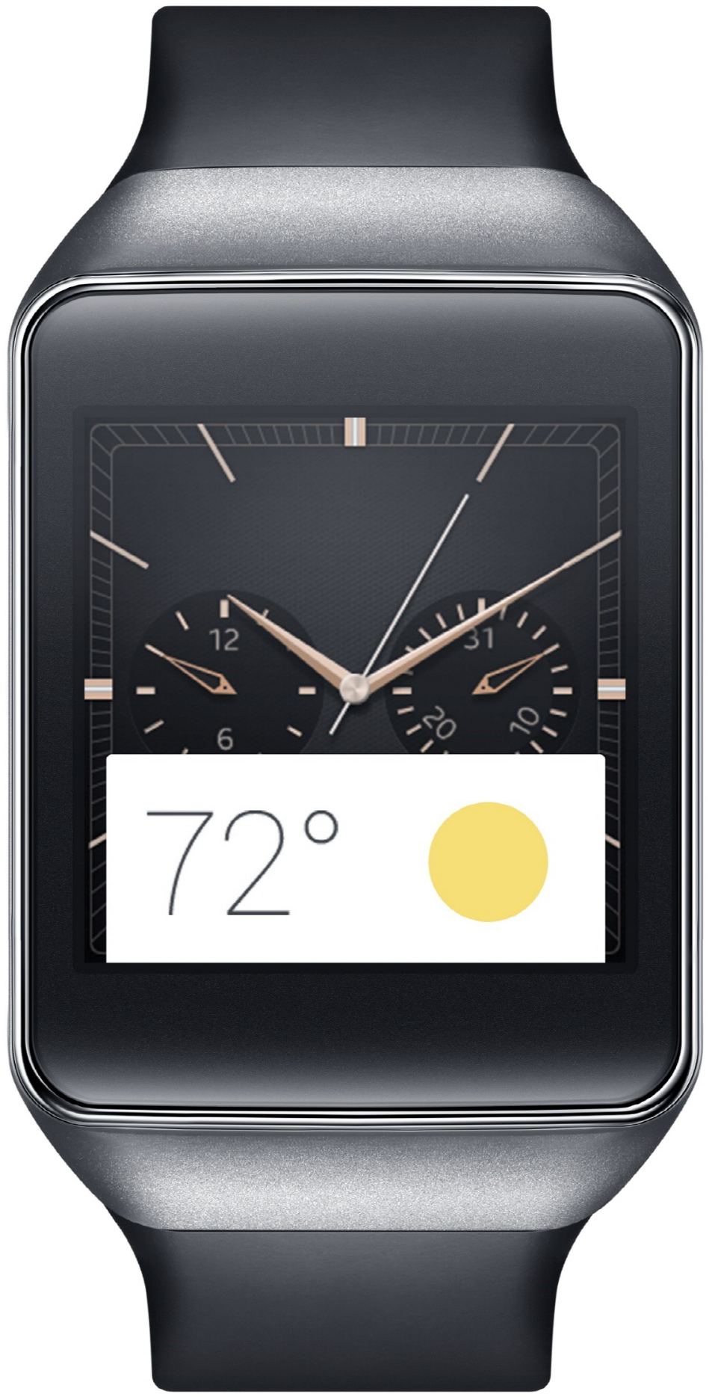
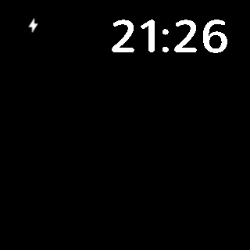

Slide 6
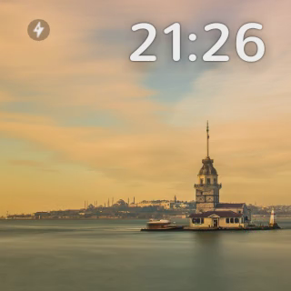

Slide 7
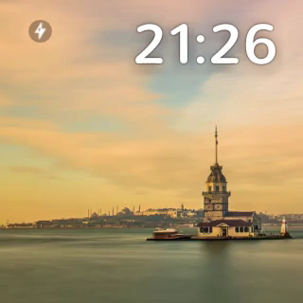

Slide 9
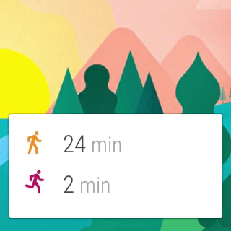

Slide 10
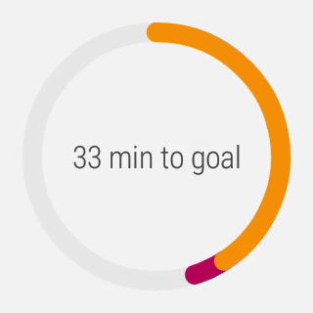

Slide 11
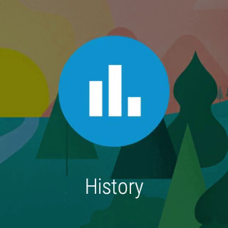

Slide 12
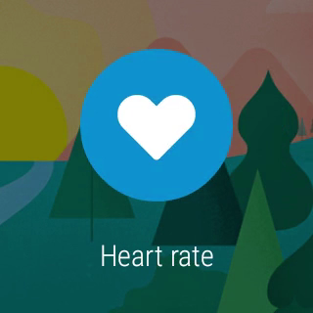

Slide 13
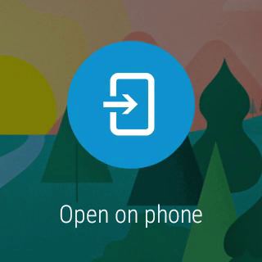

Slide 14
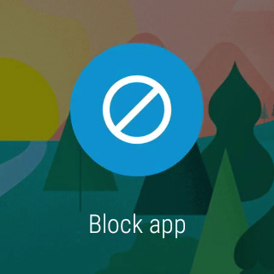

Slide 15
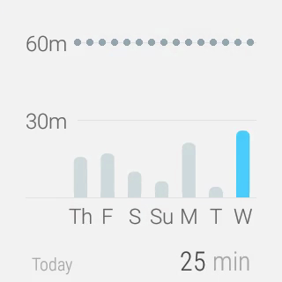

Slide 16
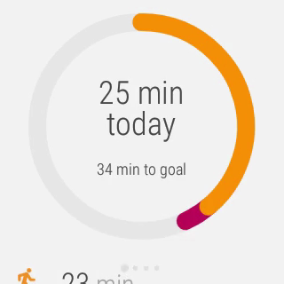

Slide 18

Creative vision

Slide 19
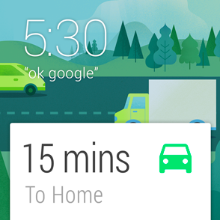
Launched automatically
Cards appear on the stream when they become relevant
“Android Wear is timely, relevant and very specific.”
Notes:
“Android Wear is timely, relevant and very specific.”

Slide 20
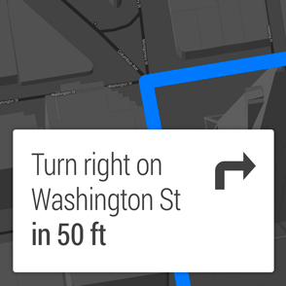
Glanceable
See information in a split second
“Android Wear is fast, sharp, and immediate.”
Notes:
“Android Wear is fast, sharp, and immediate.”

Slide 21
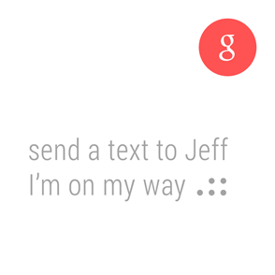
Suggest and demand
Only interrupts you when necessary and always on hand to provide an answer
“Android Wear is helpful, respectful, and responsive.”
Notes:
“Android Wear is helpful, respectful, and responsive.”

Slide 22
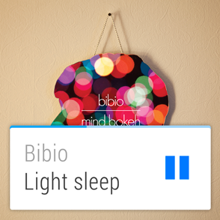
Zero or low interaction
Input rarely needed, and avoids fine-grained finger movements
“Android Wear is gestural, simple, and fast.”
Notes:
“Android Wear is gestural, simple, and fast.”

Slide 23

Under the hood

Slide 24
It’s Android
Android-powered wearable on your wrist
Running 5.0 Lollipop
Specially designed apps for Wear

Slide 25
It’s not a replacement
Connected to phone or tablet
Portal to the internet
Mirrors notifications
Requires 4.3+

Slide 26
Watchfaces Notifications Wear apps

Slide 27
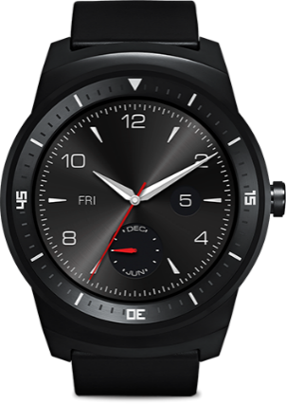
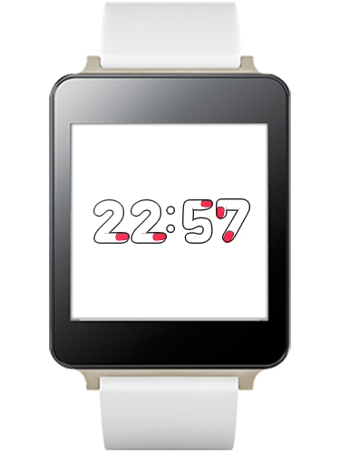
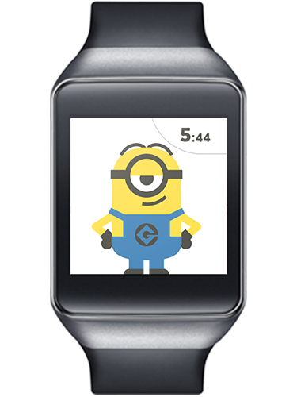
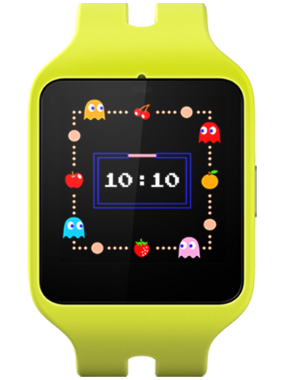
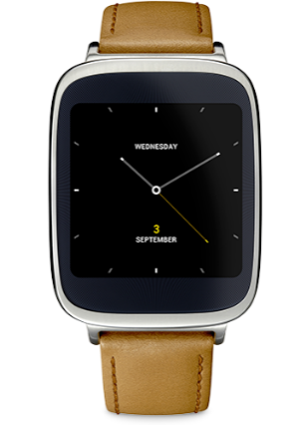
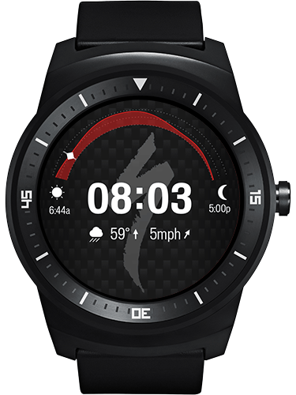
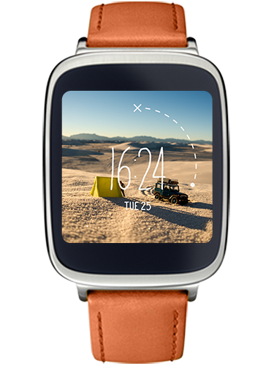
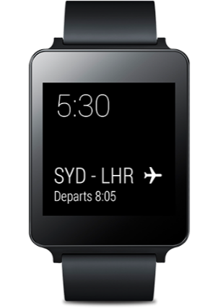
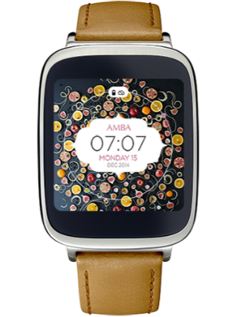
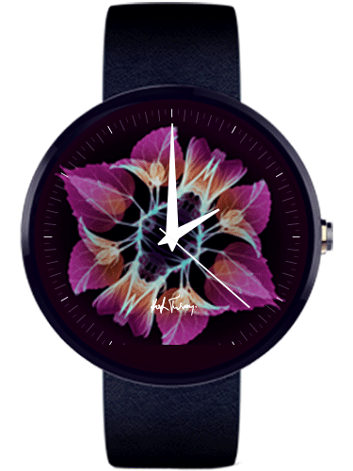
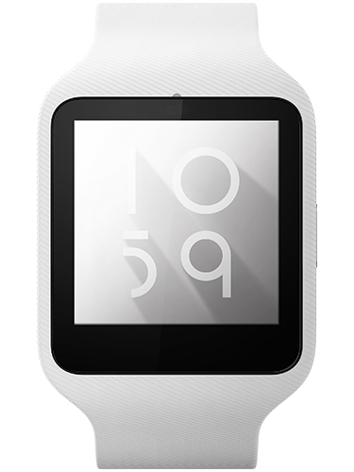
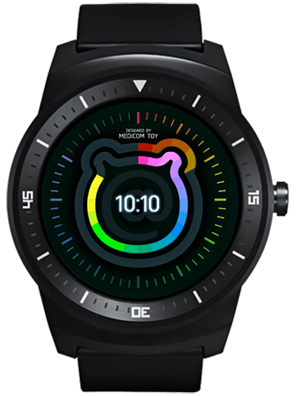
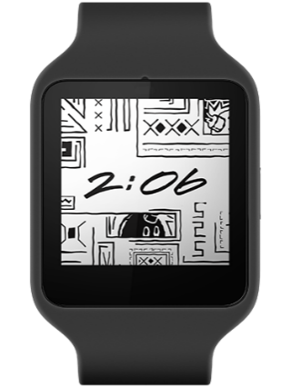
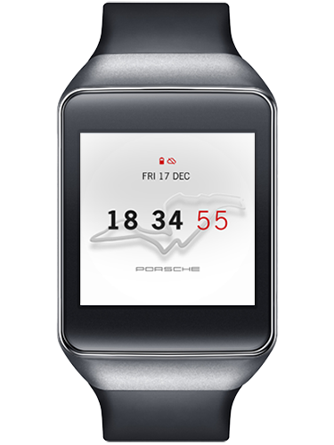
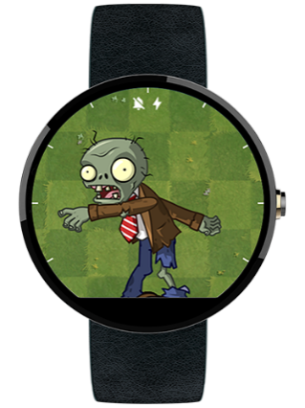
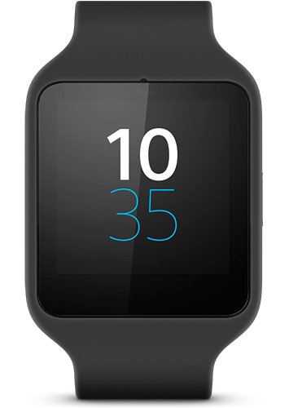
Watchfaces
Notes:
Custom watchfaces.

Slide 28
Watchfaces
Until Lollipop, no standard
Draws on a OpenGL-backed canvas inside a Service

Slide 29
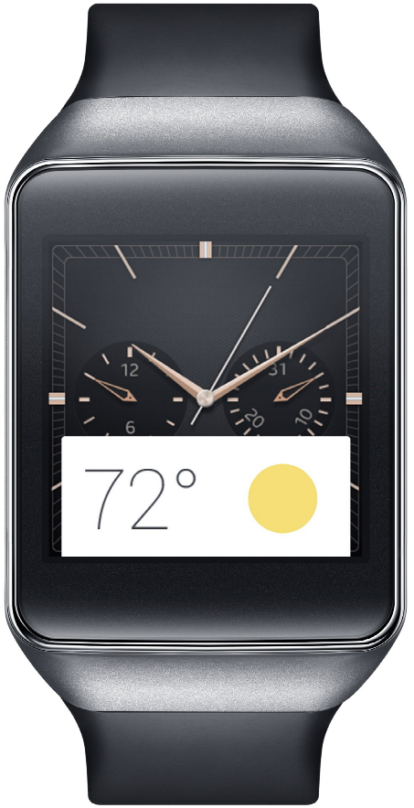
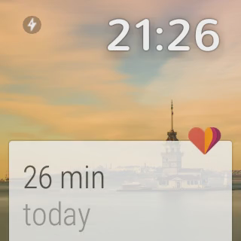
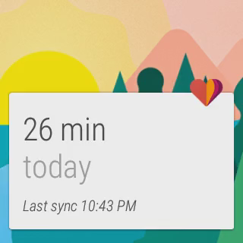
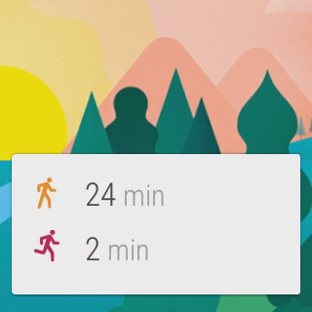
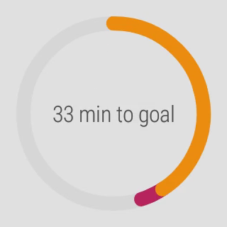
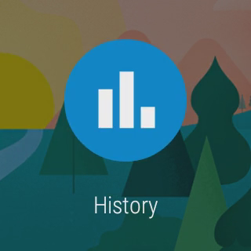
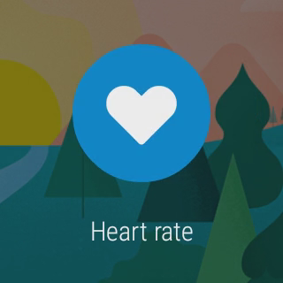
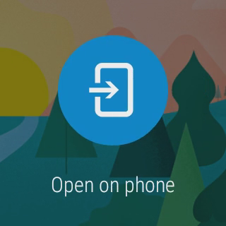
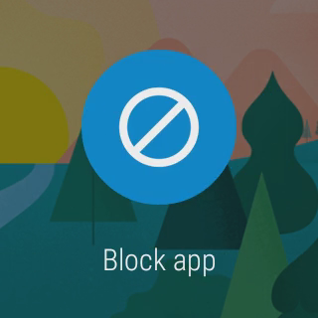
Notifications

Slide 30


Notifications
NotificationCompat works “out of the box”
}
}
}
Title, description and icon
Actions
Reserved actions

Slide 31
Enriching notifications with voice reply
Replying by voice

Slide 32
Enriching notifications with voice reply
Add RemoteInput to Reply action
Action replyAction = new NotificationCompat.Action.Builder( R.drawable.ic_reply, getString(R.string.reply), replyPendingIntent) .addRemoteInput( new RemoteInput.Builder(EXTRA_REPLY_TEXT) .setLabel(getString(R.string.replyLabel)) .build()) .build();

Slide 33
Enriching notifications with voice reply
Modify app to use reply text
Bundle results = RemoteInput.getResultsFromIntent(intent); if (results != null) { String message = results.getString(EXTRA_REPLY_TEXT); }
Bonus: this doesn’t alter existing app behavior

Slide 34

Wear apps

Slide 35
Wear apps
APK for Wear is bundled inside the mobile’s APK
Enhanced with:
Pages
Actions
Replies
Custom backgrounds

Slide 36
Wear apps
http://developer.android.com/design/wear/principles.html
http://developer.android.com/design/wear/structure.html

Slide 37


…and more!

Slide 38
Debugging
Attach the watch via USB
Enable debugging on the wearable:
Tap the home screen twice to bring up the Wear menu.
Scroll to the bottom and tap Settings.
Scroll to the bottom and tap the Developer Options. If there's no Developer Options item, tap About, and then tap the build number 7 times.
Enable ADB debugging.

Slide 39

Debugging
Approve your computer’s RSA signature in the pop-up on your phone

Slide 40
Debugging over Bluetooth
Enable Bluetooth debugging on the wearable:
Tap the home screen twice to bring up the Wear menu.
Scroll to the bottom and tap Settings.
Scroll to the bottom and tap the Developer Options. If there's no Developer Options item, tap About, and then tap the build number 7 times.
Enable Debug over Bluetooth.

Slide 41
Debugging over Bluetooth
Connect the handheld to your machine over USB
Run: adb forward tcp:4444 localabstract:/adb-hub adb connect localhost:4444
Approve your computer’s RSA signature in the pop-up on your phone

Slide 42
Tips
Use a common project to share constants between your wear and handheld

Slide 43
Gotchas!

Slide 44
Useful stuff

Slide 45


Added value

Slide 46
Wear′s the Party!
Source code & slides: http://github.com/Pixplicity/weardemo
Paul Lammertsma
CTO, Pixplicity
@officesunshine

